Slide 1
Introduction to .NET

Slide 2
History
The development of .net has been started by Microsoft with the development of framework only in the late 90's originally under the name NGWS(Next Generation Windows Services).To develop the framework 1st a setup specification were prepared known as CLI(Common Language Infrastructure) Specification.
CLI Specifications are standardized under ISO and ECMI(European Computer Manufacturing Association) making them as open specifications giving a chance for every one to develop the framework.
Definition:
A programming infrastructure created by Microsoft for building,
deploying, and running applications and services that use .NET technologies,
such as desktop applications and Web services.

Slide 3
.NET – What Is It?
Software platform
In other words:
  .NET is not a language (Runtime and a library for writing and executing written programs in any compliant language)

Slide 4
What Is .NET
It is a platform for application developers.
It is a Framework that supports Multiple Language and Cross language integration.
IT has IDE (Integrated Development Environment).
Framework is a set of utilities or can say building blocks of your application system.
.NET Framework provides GUI in a GUI manner.
.NET is a platform independent but with help of Mono Compilation System (MCS). MCS is a middle level interface.
.NET Framework provides interoperability between languages i.e. Common Type System (CTS) .
.NET Framework also includes the .NET Common Language Runtime (CLR), which is responsible for maintaining the execution of all applications developed using the .NET library.

Slide 5
.NET – What Is It?
.NET Application
.NET Framework
Operating System + Hardware

Slide 6






Framework, Languages, And Tools
VB
VC++
VC#
JScript
…
Visual Studio.NET
Common Language Specification
ASP.NET: Web Services
and Web Forms
Windows
Forms
ADO.NET: Data and XML
Base Class Library
Common Language Runtime
Notes:
The .NET framework exposes numerous classes to the developer. These classes allow the development of rich client applications and Web based applications alike. In the above slide these classes have been divided into 4 areas.
ASP.NET provides the core Web infrastructure such as Web Forms for UI based development and Web Services for programmatic interface development,
User interface development on the Windows platform can be done using Windows Forms
ADO.NET and XML provide the functionality for data access.
Finally, the core base classes provide infrastructure services such as security, transaction management etc.

Slide 7
The .NET Framework
.
Common Language Runtime
Windows® Forms
ASP.NET
  Web Forms
  Web Services
ADO.NET, evolution of ADO
Notes:
Common Language Runtime
Common, secure execution environment.
We’ll drill into this in some detail in the first parts of the presentation.
Windows® forms
Framework for building rich clients
A demonstration will highlight some of these features, such as the delegate-based event model.
ASP.NET
Web forms
Manageable code (non spaghetti)
Logical evolution of ASP (compiled)
Again, we’ll drill into a hint at the power of Web Forms with a demonstration
Web Services
Programming the Internet to leverage the "power at the edge of the cloud".
We will cover this in detail, as this – along with the CLR – is one of the more powerful aspects of .NET Framework.
ADO.NET, evolution of ADO
New objects (e.g., DataSets, Datareader)
Visual Studio.NET
Most productive development environment gets better and fully supports the .NET Framework

Slide 8
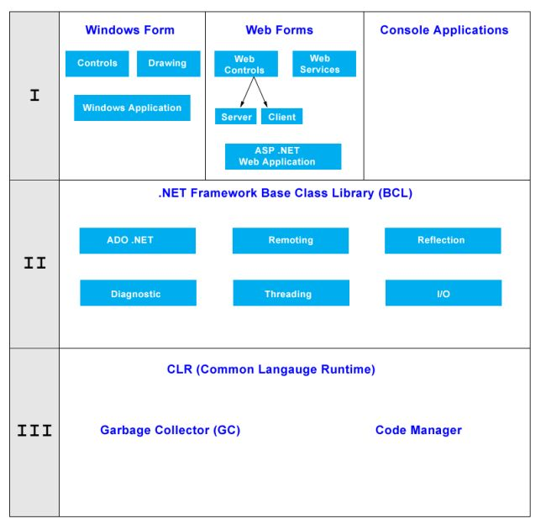
Architecture of .NET Framework
Notes:
The System.Diagnostics namespaces contain types that enable you to interact with system processes, event logs, and performance counters. Child namespaces contain types to interact with code analysis tools, to support contracts, to extend design-time support for application monitoring and instrumentation, to log event data using the Event Tracing for Windows (ETW) tracing subsystem, to read to and write from event logs and collect performance data, and to read and write debug symbol information.

Slide 9
Common Language Runtime (CLR)
CLR works like a virtual machine in executing all languages.
All .NET languages must obey the rules and standards imposed by CLR. Examples:
  Object declaration, creation and use
  Data types,language libraries
  Error and exception handling
  Interactive Development Environment (IDE)

Slide 10
Common Language Runtime
Development
  Mixed language applications
    Common Language Specification (CLS)
    Common Type System (CTS)
    Standard class framework
    Automatic memory management
  Consistent error handling and safer execution
  Potentially multi-platform
Deployment
  Removal of registration dependency
  Safety – fewer versioning problems

Slide 11
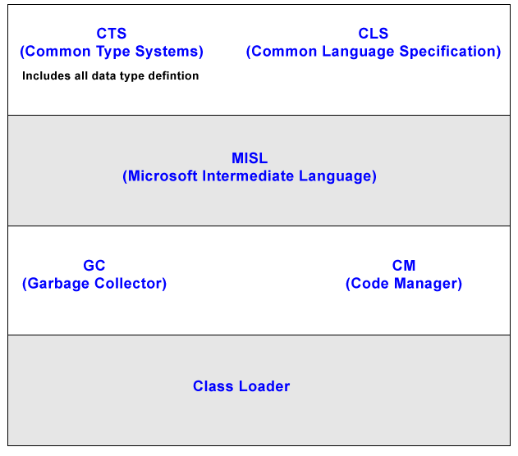
Architecture of CLR

Slide 12
Common Language Runtime
Multiple Language Support
CTS is a rich type system built into the CLR
  Implements various types (int, double, etc)
  And operations on those types
CLS is a set of specifications that language and library designers need to follow
  This will ensure interoperability between languages

Slide 13
MSIL (Microsoft Intermediate Language)
It is language independent code. When you compile code that uses the .NET Framework library, you don't immediately create operating system - specific native code.
Instead, you compile your code into Microsoft Intermediate Language (MSIL) code. The MSIL code is not specific to any operating system or to any language.
Garbage Collection (GC)
One of the most important features of managed code is the concept of garbage collection. This is the .NET method of making sure that the memory used by an application is freed up completely when the application is no longer in use.
Code Manager
Code manager invokes class loader for execution.
NET supports two kind of coding
1) Managed Code
2) Unmanaged Code

Slide 14
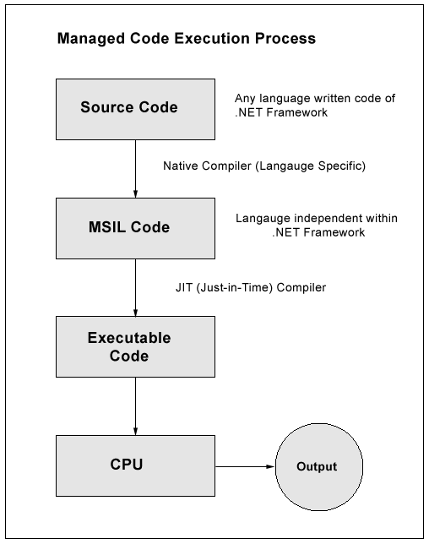
Managed Code
The code, which is developed in .NET framework, is known as managed code. This code is directly executed by CLR with help of managed code execution. Any language that is written in .NET Framework is managed code.

Slide 15
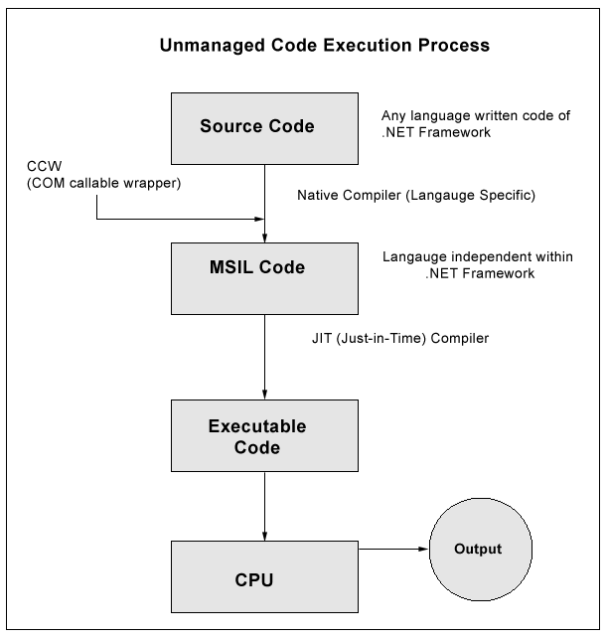
Unmanaged Code
The code, which is developed outside .NET, Framework is known as unmanaged code.

Slide 16
Intermediate Language (IL)
.NET languages are not compiled to machine code. They are compiled to an Intermediate Language (IL).
CLR accepts the IL code and recompiles it to machine code. The recompilation is just-in-time (JIT) meaning it is done as soon as a function or subroutine is called.
The JIT code stays in memory for subsequent calls. In cases where there is not enough memory it is discarded thus making JIT process interpretive.

Slide 17
JIT (Just-in-Time)
Just - in - Time (JIT) compiler, which compiles MSIL into native code that is specific to the OS and machine architecture being targeted. Only at this point can the OS execute the application. The just - in - time part of the name reflects the fact that MSIL code is only compiled as, and when, it is needed.
In the past, it was often necessary to compile your code into several applications, each of which targeted a specific operating system and CPU architecture. Often, this was a form of optimization.
This is now unnecessary, because JIT compilers (as their name suggests) use MSIL code, which is independent of the machine, operating system, and CPU. Several JIT compilers exist, each targeting a different architecture, and the appropriate one will be used to create the native code required.

Slide 18
TYPE OF JIT
Pre JIT
It converts all the code in executable code and it is slow
Econo JIT
It will convert the called executable code only. But it will convert code every time when a code is called again.
Normal JIT
It will only convert the called code and will store in cache so that it will not require converting code again. Normal JIT is fast.

Slide 19
Compilation in .NET
Code in VB.NET
Code in C#
Code in another
.NET Language
VB.NET compiler
C# compiler
Appropriate
Compiler
IL(Intermediate
Language) code
CLR just-in-time
execution

Slide 20
Languages
Languages provided by MS
  VB, C++, C#, J#, JScript
Third-parties are building
  APL, COBOL, Pascal, Eiffel, Haskell, ML, Oberon, Perl, Python, Scheme, Smalltalk…

Slide 21
Windows Forms
Framework for Building Rich Clients
  RAD (Rapid Application Development)
  Rich set of controls
  Data aware
  ActiveX® Support
  Licensing
  Accessibility
  Printing support
  Unicode support
  UI inheritance

Slide 22
ASP.NET
ASP.NET,the platform services that allow to program Web Applications and Web Services in any .NET language
ASP.NET Uses .NET languages to generate HTML pages. HTML page is targeted to the capabilities of the requesting Browser
ASP.NET “Program” is compiled into a .NET class and cached the first time it is called. All subsequent calls use the cached version.

Slide 23
ASP.NET
Logical Evolution of ASP
  Supports multiple languages
  Improved performance
  Control-based, event-driven execution model
  More productive
  Cleanly encapsulated functionality
Notes:
The first incarnation of ASP proved very successful. As part of the .NET Framework, Microsoft support ASP.NET. ASP.NET is a logical evolution of ASP, but addresses many of the issues associated with ASP.
ASP.NET is now compiled and not interpreted.
A great deal of work has also been done to make sure that ASP.NET development becomes cleaner and more productive.

Slide 24
ASP.NET Web Forms
Allows clean cut code
  Code-behind Web Forms
Easier for tools to generate
Code within is compiled then executed
Improved handling of state information
Support for ASP.NET server controls
  Data validation
  Data bound grids
Notes:
The Web Form is basically an ASP.NET file (.ASPX) that makes use of the new features of ASP.NET. ASP.NET in conjunction with Web Forms eliminate a number of the traditional problems associated with ASP.
ASP.NET provides the developer with the option of separating the code from the UI elements using ‘code-behind’ forms. Using such a mechanism will also make Form tools much easier to develop.
ASP.NET also conquers one of the annoying side effects of using ASP – state. Imagine that a user has filled in an ASP generated form and then hits the submit button. At this stage IIS (server side) will regenerate the form and as a side effect all the information that the user entered into the form will be erased. In many situations this is unacceptable, and many an ASP developer has struggled to find work arounds (most of which may not be considered elegant). Fortunately, ASP.NET allows controls to maintain state.
ASP.NET supports a number of new rich server controls. These controls can be used to improve data connectivity (data bound controls) and data validation.

Slide 25
ASP.NET Web Services
A technical definition
  “A programmable application component accessible via standard Web protocols”
Notes:
Technically a Web Service is “A programmable application component accessible via standard Web protocols”. In other words, it’s a component that can be called remotely, over the internet, from a client application.
Take our previous example of a Web application that required ‘stock information’. This Web application possibly would not have that information readily at hand. However, what if another Web application (possibly on another machine, on the other side of the planet) did? Further more what if this remote machine exposed a component with a method such as ‘GetStockPrice (string strCompanyName)’. Surely this would make life much easier, making separate Web sites act like ‘one big application’.
Web service consumers can send and receive messages using XML, and therefore the audience of clients is unlimited.

Slide 26
Web Services
It is just an application…
…that exposes its features and capabilities over the network…
…using XML…
…to allow for the creation of powerful new applications that are more than the sum of their parts…

Slide 27
ADO.NET
(Data and XML)
New objects (e.g., DataSets)
Separates connected / disconnected issues
Language neutral data access
Uses same types as CLR
Great support for XML

Slide 28
Visual Studio.NET
Development tool that contains a rich set of productivity and debugging features

Slide 29
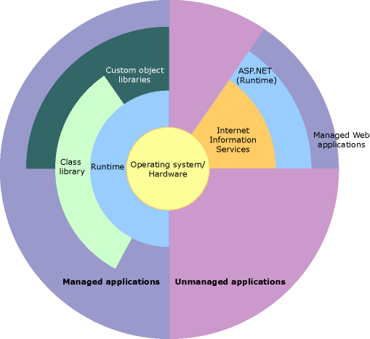
.NET – Hierarchy, Another View
CLR
CLR

Slide 30
Summary
The .NET Framework
  Dramatically simplifies development and deployment
  Provides robust and secure execution environment
  Supports multiple programming languages

Slide 31
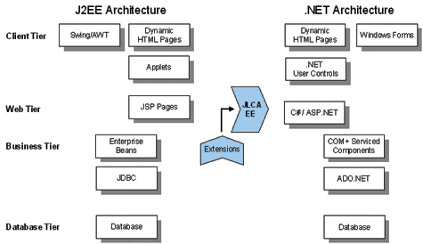
Comparison between J2EE and .NET Architectures

Slide 32
J2EE and .NET
Execution Engine
J2EE
Java source code compiles into machine-independent byte code
Runtime Environment : JVM
.NET
Any compliant language compiles into MSIL
Runtime environment : CLR
Both JVM and CLR ,support services, such as code verification, memory management via garbage collection, and code security

Slide 33
J2EE and .NET
Cross Platform Portability
J2EE
Platform Independent
JDK should exist on target machine
.NET
Supports Windows platform
CLR should exist on target machine
Can support other platforms provided it has its own JIT complier

Slide 34
J2EE and .NET
Language Support
J2EE
Tied to Java
Supports other languages via interface technology
.NET
Language independent
Supports any language if mapping exists from that
language to IL

Slide 35
J2EE and .NET
Tools Support
J2EE
Can employ any number of tools
Pro :Developer has a great deal of choice
Con :Difficulty in choosing a right tool for a given job
.NET
Visual Studio.NET, single IDE for building an application

